Slide 1
May 24, 2023 | DeVos Place
Notes:
Chad

Slide 2
Introductions
Event Management – West MI Works!
Project manager, Maggie Ryan
Director of development and innovation, Chad Patton
Industry Council Leads– West MI Works!
Advanced manufacturing lead, Jerry Hill
Agribusiness lead, Karrie Brown
Construction lead, Mac Dodds
Health sciences lead, Trevor Mier
Information technology lead, John Rumery
Intermediate Schools Districts (ISDs)
Allegan Area Educational Services Agency, Beth Johnston
Barry ISD, Rich Franklin
Ionia ISD, Ashli Jordan
Kent ISD, Eric Kelliher
Montcalm Area ISD, Penny Dora
Muskegon Area ISD, Steven Pettifor
Ottawa Area ISD, David Ladd
Employer Champions
Advanced Manufacturing
  Dave Thelen, GR Tooling and Automation
  Mike Stevens, Rockwell Automation
Agribusiness
  Mary Rottschafer, Critter Barn
Construction
  Kevin Lutz, Feyen Zylstra
  John A. Hartwell, Operating Engineers Local 324
Health Sciences
  Kelly Elkins, Trinity Health
  Rob Ayotte, Corewell Health
  Steven Smith, University of Michigan Health - West
Information Technology
  Sharon Vriend-Robinette, Spectrum Health Information Technology
Notes:
Chad – thank you to all that participate, this is a community event, shout out to ISDs, WMW staff, employer champions, and ICLs. We are super excited to have agribusiness join the industries for the first in-person event.
Introduce Maggie

Slide 3

75 million workers will retire by 2030, yet only 51 million workers will enter the workforce to replace them.
The
Need
What are we doing to ensure they choose a career in Agribusiness?
Advanced Manufacturing?
Construction?
Health Sciences?
Information Technology?
Notes:
THE "WHY " BEHIND MICQ
75 million workers will retire by 2030, yet only 51 million workers will enter the workforce to replace them. On top of that, by 2030the bureau of labor statistics predicts an increase of nearly 12 million jobs from 2020 to 2030. So what can we do to promote our most high demand industries? One answer for our community, was MiCareerQuest.
Brief history: MiCareerQuest, an innovative, experiential career event, was created in 2015 by Michigan Works! Kent, Allegan & Barry Counties (now West Michigan Works!), Kent ISD and the Construction Workforce Development Alliance (CWDA) in response to employers’ need for future talent in construction, health care, information technology and manufacturing.
In 2016, MiCareerQuest's first affiliate event was held in Kalamazoo and today , the event has been adopted as a best practice statewide. Now, employers and industry alliances across the country are hosting CareerQuestUSA events to expose students to the wealth of career possibilities in their regions.

Slide 4
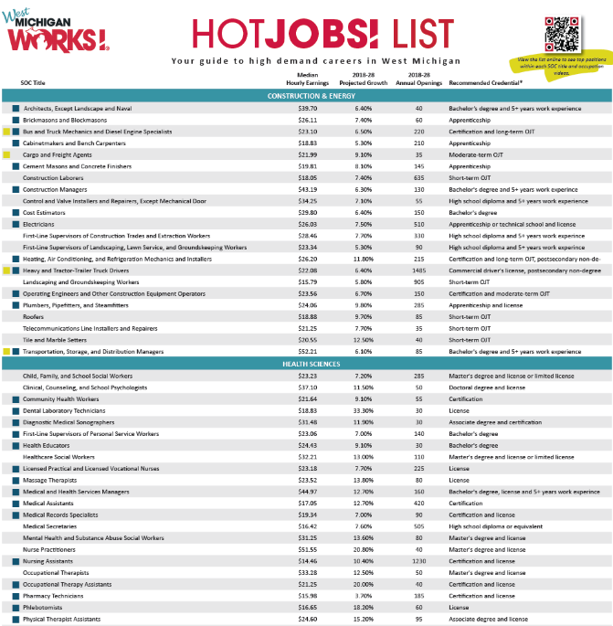





Industry Talent Councils
The data-based HotJobs! List guides which jobs are featured at the event.
Notes:
The event is backed by the 5 employer-led industry talent council, who's logo are displayed on the screen. Each council is committed to solutions to address the skilled workforce needs of West Michigan companies. A few key areas of focus for each industry are: promoting the industry, recruitment, retention, and funding for talent related initiatives.
Who They Are:
Employers, educators, workforce development experts
What They Do:
Create solutions to address the skilled workforce needs of West Michigan companies
One way that they do this:
MiCareerQuest

Slide 5
When
Event Day - Wednesday, May 24, 2023
Volunteer arrival: two shifts
Morning – park at 7:00 am
arrive to DeVos and check in at 7:30
Afternoon – shift starts at 11 am
Where
DeVos Place Convention Center
303 Monroe Ave NW, Grand Rapids, MI 49503
  What
  Interactive, hands-on, inspiring
Event Overview
Notes:
When and where
What:
MiCareerQuest is not your average career fair. In fact, it’s not a career fair at all. It’s a career exploration experience.
During MiCareerQuest, students rotate through sectors highlighting five high-demand industries: agribusiness, advanced manufacturing, construction, health sciences and information technology. Students engage directly with professionals and participate in activities that showcase various high-growth occupations, opening their eyes to opportunities for great careers in West Michigan.
Additionally, representatives from educational institutions help students make the connection between training, education and careers.

Slide 6
DeVos hall will be divided into four industry quadrants.
Industry champions will have interactive, engaging, and motivating exhibits showcasing the career opportunities within their industry.
Higher Education Sponsors will be strategically placed throughout DeVos hall to maximize exposure to students.
Quadrants will be piped and draped in a color matching initial lanyard entrance color, with an entrance and an exit to facilitate student movement.
The Layout
Notes:
Session Times Notes:
Student Flow Notes:
Post Event Notes:

Slide 7
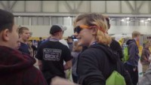
What is MiCareerQuest?
…and agribusiness!
Notes:
Employers participating in their first MiCQ event, often stat they wish they was a better way to prepare employers for what they would experience. This video showcases activities from a previous event
We would like play that for you now.

Slide 8
    8337 students registered.
    92 companies represented.
    284 jobs represented.
2023 Highlights
“I liked being able to look at careers from a broad spectrum rather than just engineering or just medical, etc. It broadened my views on what I might possibly be interested in. It was also a great way to learn about opportunities to prepare for a career in the future.” – 2018 Participant

Slide 9
Arrival

Slide 10
Bus Parking
Get bus driver’s phone number to
reconnect after event

Slide 11
Every student and chaperone should have lanyard and every student should have a backpack. No outside student backpacks allowed except medical devices.
Every exhibitor should have a lanyard
Every tour guest and media contact should have a lanyard
Every volunteer should have a bright pink shirt
If someone doesn’t have one of these, point to info desk
No storage for personal items
Wear comfortable shoes! No high heels, no new shoes
Arrival: outfits and suggestions

Slide 12
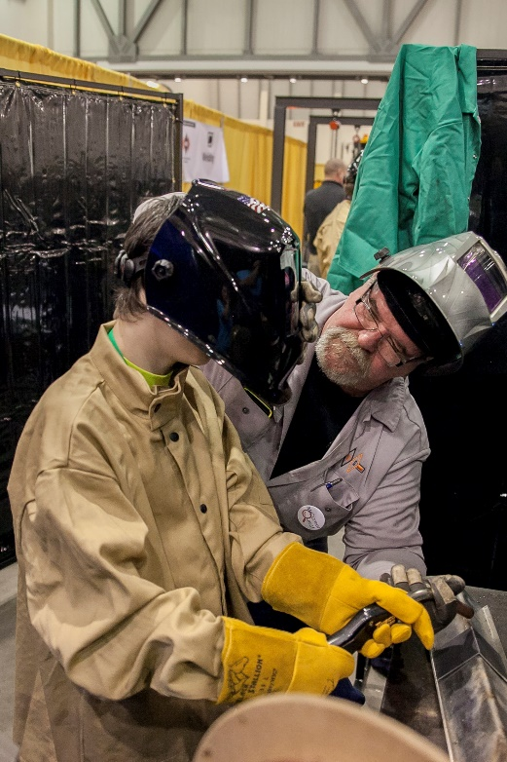
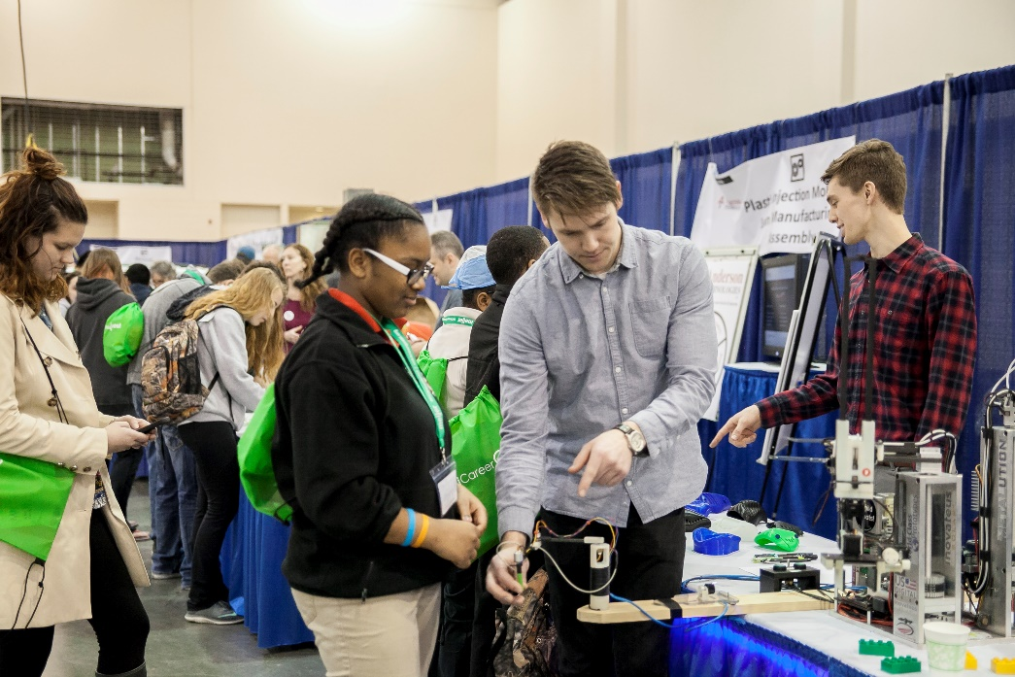
Students come in from one of three sessions:
    8:30 am – 10:15 am
    10:15 am – Noon
    Noon – 1:45 pm
  Students start in one of the exhibit spaces and move throughout the hall to experience all five industries.
  Music plays when it is time for students to move to the next quadrante Arrival/Early Departures Process
    Schools arriving late will be escorted by Exhibit Hall CJ Student Volunteers to the industry sector based on the rotation schedule that aligns with their arrival time (see event schedule document)
Student Experience

Slide 13
Student Flow

Slide 14
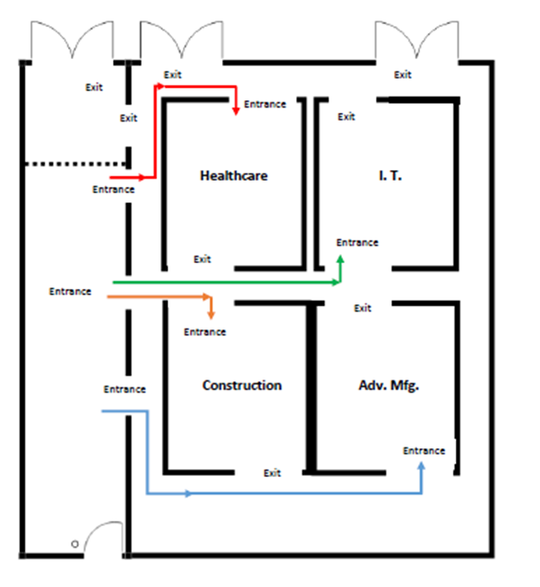
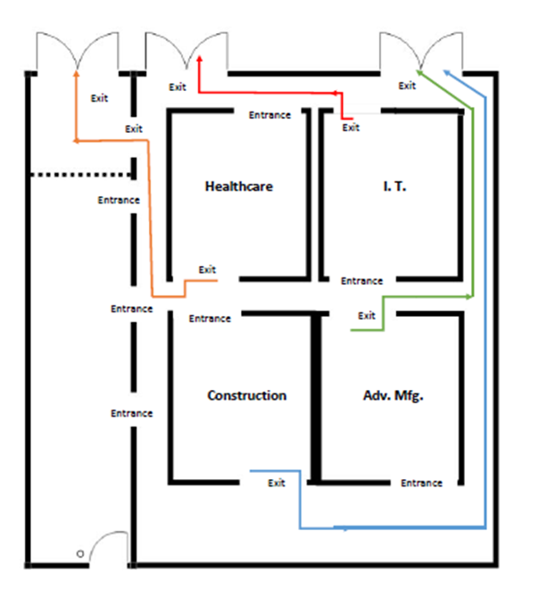
ENTRANCE/EXIT PLANS
Exit Plan on
every student lanyard
Notes:
Review CJ Student Position Descriptions for Grand Gallery Flow (Mark) and Exhibit Hall (Craig)

Slide 15
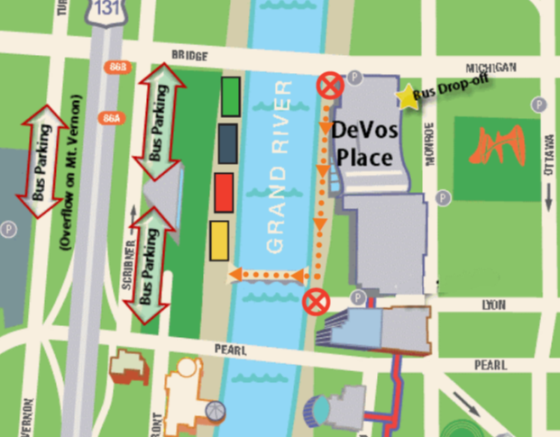
Exterior Exit Plan
School signs used to meet students here

Slide 16
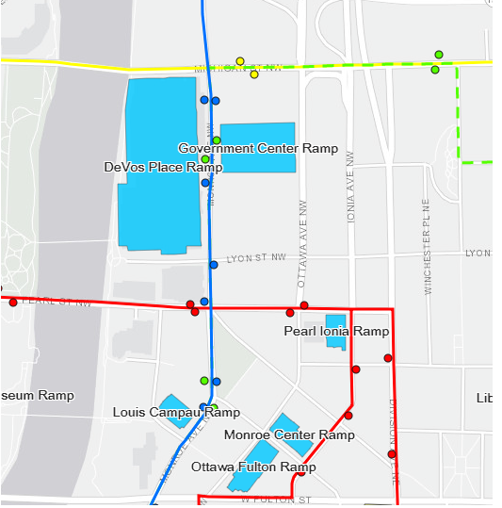
        Underneath DeVos Place (entrance off Michigan Street by the river)
        Overflow in the Government Parking Ramp across Monroe.
            Parking vouchers will be provided (one/person/day)
Parking

Slide 17
Runners: Dispatch Office, Grand Gallery
Industry Guides: WMW Sector Tables, Exhibit Hall
Grand Gallery Flow: Box Office, Grand Gallery
Exit Flow: Box Office, Grand Gallery
Exhibit Hall Flow: Box Office, Grand Gallery
Transportation: Main Entrance, Grand Gallery
Please note: Transportation volunteers are to meet at 7:30AM at the Monroe entrance
Volunteer Meeting Points

Slide 18
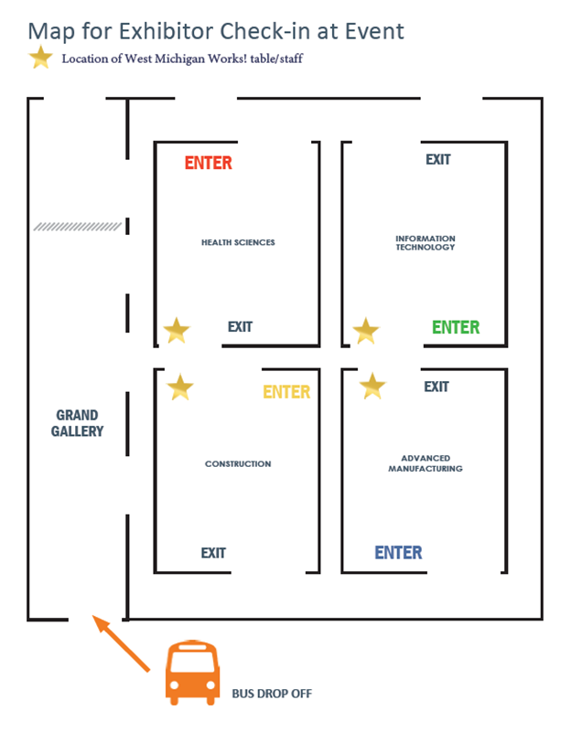
Industry Area Check In
(Exhibitors, Volunteers)

Slide 19
Bus Arrival, Bus Greeters A, Bus Greeters B
Grand Gallery Floor, Grand Gallery Exhibit Hall Door Guards
Student Guides, Exhibit Hall
Industry Guides
WMW Quadrant Information
Floating Runners
VIP Tour Check In
Info Desk
Exit - Flag Holders
Volunteer Positions

Slide 20
    ALL DAY VOLUNTEER SCHEDULE:
      Arrival/Park 7:30 am
      Check-in: 7:45 am
      Volunteer Tours: 8:00 am
      Lunch (by rotation): 11:00 am – 1:00 pm
      Clean Up: 1:45 pm
      Depart When clean up is complete.
    LUNCH – BY LAST NAME
      A-D 11:00 - 11:30
      E-H 11:30 – Noon
      I-N Noon – 12:30
      O-Z 12:30 – 1:00
Volunteer Schedule
OTHER BREAKS – Take as needed, just please ensure you are covered.

Slide 21
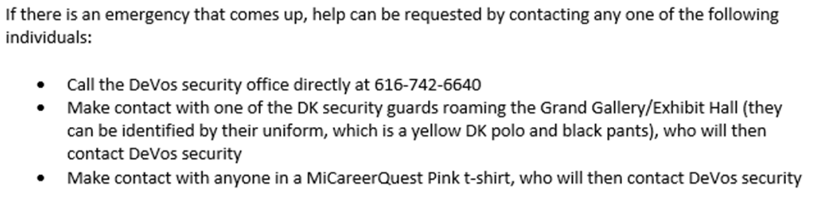
Emergency Procedure

Slide 22
ALL ATTENDEES WILL HAVE AN IDENTIFIER
Anyone without an identifier should be asked to go to the Info Desk.
Students and school personnel: MICQ lanyards in primary colors with name badges attached.
Volunteers: MICQ t-shirts in neon pink.
Exhibitors: MICQ lanyards in industry colors with name badges attached.
Tour participants and guests: MICQ lanyards in white with name badges attached.
Safety Continued

Slide 23

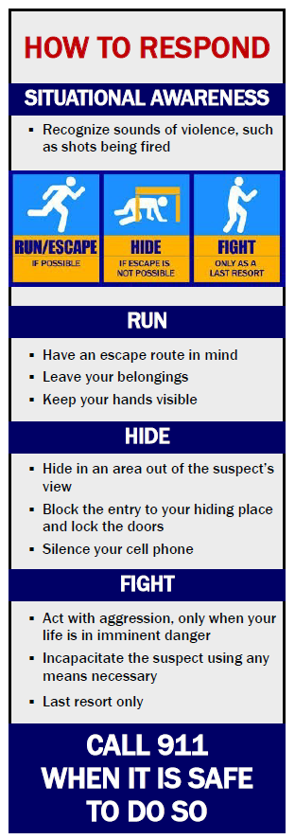
Safety Continued
BE SITUATIONALLY AWARE
Note your surroundings
Locate the closest exits
Look around and listen for anything that seems out of place
Use common sense
If you see something, say something!

Slide 24
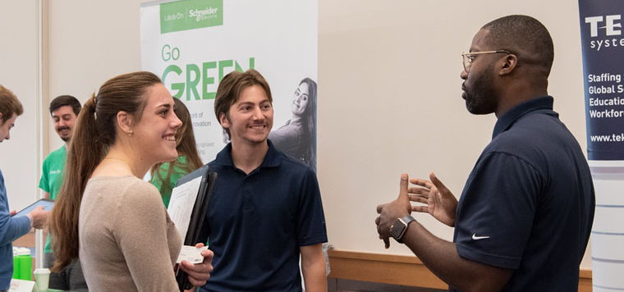
Be likeable
Show some enthusiasm
Keep it simple and jargon-free
Explain the why, not just the what
Make it a conversation, not a speech
Give them something worth remembering
Engagement Tips:
Eric Kelliher, Kent ISD

Slide 25
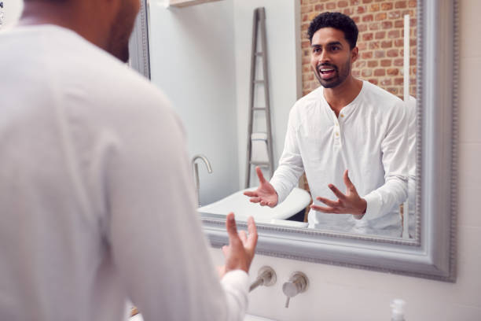

Practice in a mirror first
Practice with a colleague
Practice scenarios
Engagement Tips:
Eric Kelliher, Kent ISD

Slide 26
Questions?

Slide 27
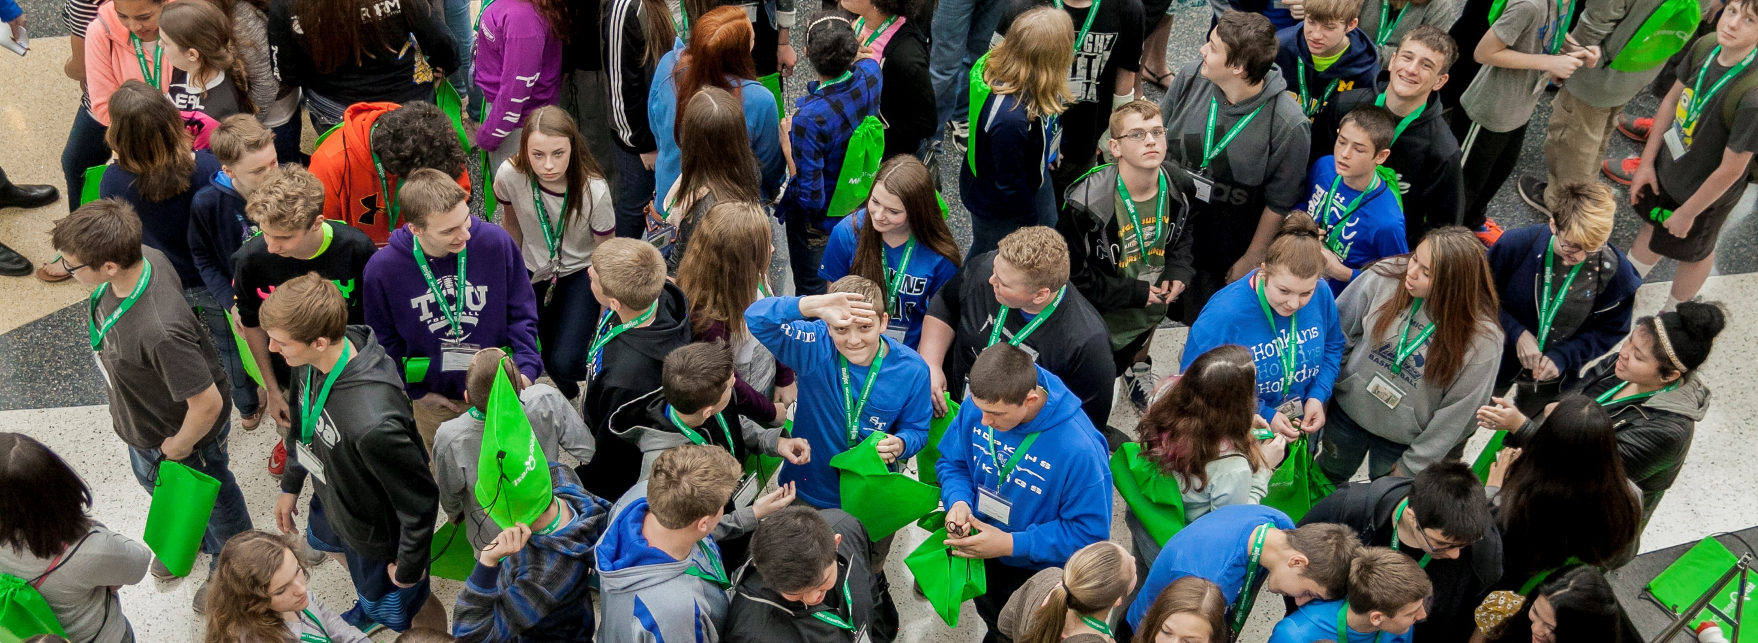
THANK YOU!
THANK YOU!
Volunteers – Pick up T-Shirts
Notes:
We’d like to end our presentation the same way we started: with a big THANK YOU!!

Slide 28
COMPANY PROMOTION & SIGNAGE
Company banners or table clothes are not allowed
Each exhibit will receive a standard identification sign with the occupation(s) and and logo(s) of the participating
exhibitors. These banners will be hung by volunteers on set-up day.
Distribution of papers such as brochures, promotional items, pamphlets, and flyers, are not permitted
within the exhibit hall quadrants.
    However, distribution of papers such as brochures, pamphlets, and flyers, are permitted at the following tables:
      Sponsoring Vendor and Educator tables located on the east side of the exhibit hall, just outside of the industry quadrants
      Sponsoring Educators may advertise their training programs within the exhibit hall quadrant(s).
Swag items are permitted if they are produced, generated, or earned by an attendee as part of the
interactive portion of an exhibit. Swag must be related to the occupation.
Please note that balloons and latex gloves are not allowed at the event venue.
Exhibitor Guidelines

Slide 29
DRESS CODE
Exhibitors representing their trade should come dressed as they would on the job.
Comfortable Shoes: Don’t forget that you’ll be working long hours on your feet and to dress accordingly. You can dress professionally and still be comfortable if you keep a few things in mind:
    Your shoes will make or break your comfort when you’re on your feet for hours. Avoid high heels and sandals; toe and foot injuries are common in areas where there is a lot of wiring for dozens of exhibits.
    Avoid wearing new shoes or you may wind up having aching, blistered feet by the end of the day.
    The Exhibit Hall is concrete. The harder the floor, the more comfortable your shoes will need to be.
Exhibitor Guidelines

Slide 30
Exhibit Supplies: Please contact your Industry Council Lead if you would like a copy of your supply order
Designated Industry set-up times: Reference “Move In/Move Out” hand out
Set-up Process
      Check in at WMW! Tables (center of exhibit hall)
      No supply check out from 12p-1p
      Supply Order Form Provided upon arrival (Wi-Fi password listed on lanyard)
      Parking Validation Provided
Set-Up: May 23

Slide 31
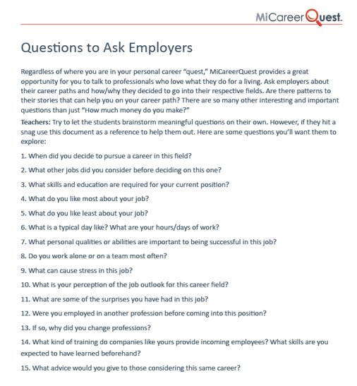
Student questions

Slide 32
  Concession stand at the DeVos Place will be open to purchase concessions from:​
  6am-11am on May 23 ​
  6am – 8am on May 24
  Vehicle Display – Fire Marshall Inspection​
  Exhibitor Survey​: Tell us what you think! In order to enhance the next MiCareerQuest experience, we depend on feedback from you. ​An electronic survey will be emailed to you immediately following the event. Your input is critically important. ​
  Results of the both the Exhibitor & Student/School survey will be reported at the MiCareerQuest 2023 Exhibitor Debrief event​ June 6th at Founders
More information

Slide 33
THANK YOU!
THANK YOU!
Notes:
We’d like to end our presentation the same way we started: with a big THANK YOU!!

