Slide 1
Going PRO Talent Fund - FY25 Cycle 1
Fact-Finding Meeting​

Slide 2
Agenda
Introductions
Overview of Going PRO Talent Fund
New for FY25
Application Timeline & Process
Scoring Criteria & Integrity
Next Steps

Slide 3
Makes competitive awards to employers to assist in training, developing, and retaining current and newly hired employees.
Training funded by the Talent Fund must be short-term and fill a demonstrated talent need experienced by the employer. Training must lead to a credential for a skill that is transferable and recognized by industry.
Helps to ensure employers have the talent they need to compete and grow
Going Pro Talent Fund

Slide 4
New for FY25
An employer with multiple sites must apply for each site separately
Leadership training is only allowable if it accompanies a technical/hard skill classroom training
All payments to the training provider must be made by the employer
In-house training is not eligible
Regional median wage increases
Allegan & Ionia= $20.65
Barry, Kent, Montcalm, Ottawa= $22.25
Muskegon= $19.38

Slide 5
New for FY25
Points if employer did not receive an independent or ELC award in FY23 or FY24
Points for training directly applicable to increasing & preserving affordable housing units
Points for training directly applicable to increasing household access to high-speed internet
Points for technical training that results in an industry recognized certification or license
Conferred college credit no longer allowable for college credit points
Employers must maintain original application's score and execute original pledged intent

Slide 6
Application Timeline
FY25 Cycle 1 Application Period: Tuesday, October 1st – Friday, October 18th at 5:00 p.m.
Tentative training period: January 1, 2025 – December 30, 2025
If awarded for FY 25 Cycle 1, employers will have until December 31, 2025 to complete training - no extensions will be allowed.
Employers previously awarded in FY24 Cycle 2 may submit a FY25 Cycle 1 application if the FY24 training is completed by December 31, 2024.
If a FY24 Cycle 2 awardee needs a full 12 months to complete training, they will be able to apply for FY25 Cycle 2.
Submit an Authorization Request in WBLOMS

Slide 7
Reimbursement
Training Type​ | Eligible Reimbursement​
Classroom​ | Up to $2,000 per person​
New Employee​ On-the-Job (OJT) Training​ | Up to $2,000 per person ​
USDOL Registered Apprenticeship​ | Up to $3,500 per person​

Slide 8
Classroom Training
Reimbursement up to $2,000 per person.
Must be live instructor led.
Online training is allowable if it’s part of USDOL Registered Apprenticeship Standards
Self-paced/on-demand training is ineligible.
Hybrid course that is both modularized and live instructor led is allowable.
Must expand and improve an employee’s skills and develop their opportunities for growth or promotion.
Must result in a certificate of completion, credential or license for a skill that is transferable and recognized by industry.
Training may not occur prior to the awarded training period.
See “FY25 Eligible & Ineligible Training Guidance” PDF from our employer portal.

Slide 9
New Hire Training
Reimbursement up to $2,000 per person.
New employees eligible for on-the-job training (OJT) reimbursement:
Must be retained a minimum of 90 days following completion of OJT period to receive full reimbursement.
Training and retention periods must both be completed within one year of the award date to receive full reimbursement.
Training may not occur prior to the awarded training period.
Targeted population incentives.

Slide 10
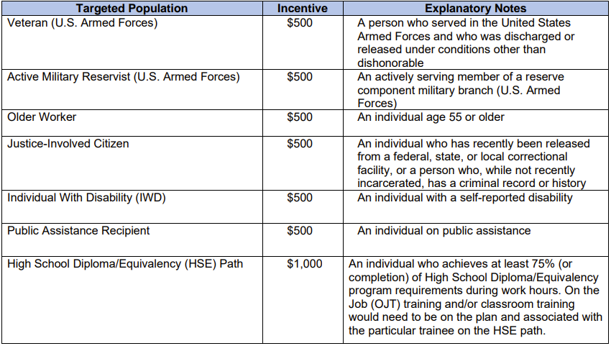
Targeted Populations

Slide 11
USDOL Registered Apprenticeship Training
Reimbursement up to $3,500 per person.
New hire or existing employees in any year of the program.
Registered apprentices may receive classroom training, on-the-job training (OJT), or a combination of both, up to the maximum reimbursement of $3,500 per person.
100% online and self-paced training is allowable if the training meets the requirements of the individual’s USDOL Registered Apprenticeship program.
Additional documentation requirements apply.

Slide 12
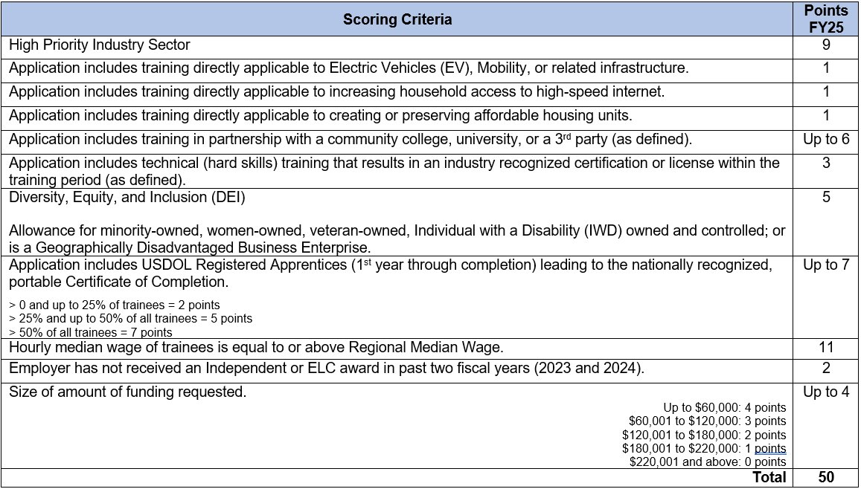
FY25 Scoring Criteria
NEW
NEW
NEW
NEW

Slide 13
Scoring Criteria & Integrity
Funding assigned to college credit on the original training plan can only be expended on college credit classes
Funding assigned to a certification or license can only be expended for the original pledged intent.
Funding assigned to USDOL RA on the original training plan can only be expended for the USDOL RA training.
Funds cannot be moved from classroom training to new hires or vice versa
Funds can only be used for the same category college credit for college credit, certification for certification, certificate for certificate, OJT for OJT etc.
Regional Median Wage
Award may be subject to de-obligation/rescission if scoring integrity is not upheld at closeout.

Slide 14
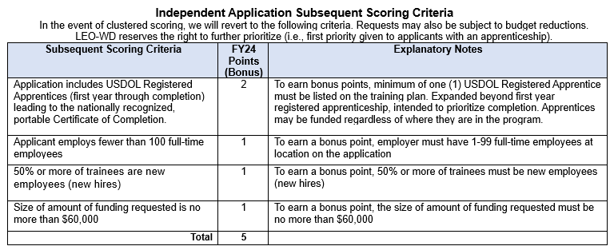
FY25 Subsequent Scoring Criteria

Slide 15
Required Application Documents
Classroom training quotes and curriculum for each class on the training plan
West Michigan Works! training plan
USDOL RA standards, 671’s, 100% OJT rationale form
Employer App Info Sheet if electing for WMW! to complete the application on employer's behalf
Training Rationale form if applicable
Send all applicable documents to BSR
Final Step complete the WBLOMS online application

Slide 16
Next Steps
Deadline October 11th to determine if applying
Validate you have an active Pure Michigan Talent Connect Account at www.mitalent.org
Access granted to WMW! Going PRO Talent Fund Employer Portal
Employer is highly encouraged to develop their proposed training plan (excel document) before logging into WBLOMS.
Classroom training will require a quote and description/curriculum to validate eligibility.
Registered apprentices will require additional documentation.
3. Application closes Friday, October 18th at 5 p.m. - no exceptions
West Michigan Works! will notify you of any discrepancies that must be resolved prior to final submission

Slide 17
MEDC
&
ED
Partners
Information & Updates

Slide 18
Olivia Blomstrom
Business Solutions Assistant Manager
(616) 490-3560
215 Straight Ave NW
Grand Rapids, MI 49504
business@westmiworks.org
10

